Slide 1
Process
WKSP 722, Module 3, Lesson 2
Notes:
Welcome back to our Process phase.

Slide 2
The Data Science Workflow
Ask questions
Prepare and Plan
Process
Analyze
Share and Act
Notes:
So as a reminder, in the past couple lessons, we learned how to work with our stakeholder to create a goal for our data science project
We also learned that it’s important to make sure you know what's in your data, you can access your data, you know where it is and that you have the right data.
In this lesson we'll go over the Process stage.

Slide 3

Process
Combining Data
Outliers
Missing Data
Notes:
In the process phase, you want to get your data ready for analyzing. So that means:
combining data if needed to run complex queries
Finding outliers in your data that might skew results and seeing if they are real or glitches in data collection
Dealing with missing data

Slide 4
Fitbit Activity Table
Activity Date | Total Steps | Total Distance
4/12/2016 | 13162 | 8.5
4/13/2016 | 10735 | 6.97
Notes:
So let's see an example of combining data. Here's a table from collection of Fitbit data you can find on the website Kaggle.com
This table has information on the number of steps and estimated distance travelled by users on particular days

Slide 5
Fitbit Sleep Table
Sleep Day | Total Sleep Records | Total Minutes Asleep | Total Time In Bed
4/12/2016 0:00 | 1 | 327 | 346
4/13/2016 0:00 | 2 | 384 | 407
Notes:
This table is shows the sleep data of users.

Slide 6
Normalize Format
Activity Date | Total Steps | Total Distance
4/12/2016 | 13162 | 8.5
4/13/2016 | 10735 | 6.97
Sleep Day | Total Sleep Records | Total Minutes Asleep | Total Time In Bed
4/12/2016 0:00 | 1 | 327 | 346
4/13/2016 0:00 | 2 | 384 | 407
Notes:
If you want to combine tables, you need to do it using a common column. Here, that could be the Date. But there's something different between the two.
What is it (one has date and time)

Slide 7
Normalize Format
Activity Date | Total Steps | Total Distance
4/12/2016 | 13162 | 8.5
4/13/2016 | 10735 | 6.97
Sleep Day | Total Sleep Records | Total Minutes Asleep | Total Time In Bed
4/12/2016 0:00 | 1 | 327 | 346
4/13/2016 0:00 | 2 | 384 | 407
table_sleep[‘SleepDay’].str.split()
Notes:
We need to split off the time – then the column format will match and you can combine the tables.

Slide 8
Normalize Format
Activity Date | Total Steps | Total Distance
4/12/2016 | 13162 | 8.5
4/13/2016 | 10735 | 6.97
Sleep Day | Time | Total Sleep Records | Total Minutes Asleep | Total Time In Bed
4/12/2016 | 0:00 | 1 | 327 | 346
4/13/2016 | 0:00 | 2 | 384 | 407

Slide 9
Join Table
Sleep Day | Time | Total Sleep Records | Total Minutes Asleep | Total Time In Bed | Total Steps | Total Distance
4/12/2016 | 0:00 | 1 | 327 | 346 | 13162 | 8.5
4/13/2016 | 0:00 | 2 | 384 | 407 | 10735 | 6.97
table_joined = pd.merge(Sleep, Activity, on=“SleepDay”)
Notes:
When you combine the tables, now you can run queries that look for patterns in number of steps and sleep outcomes.

Slide 10
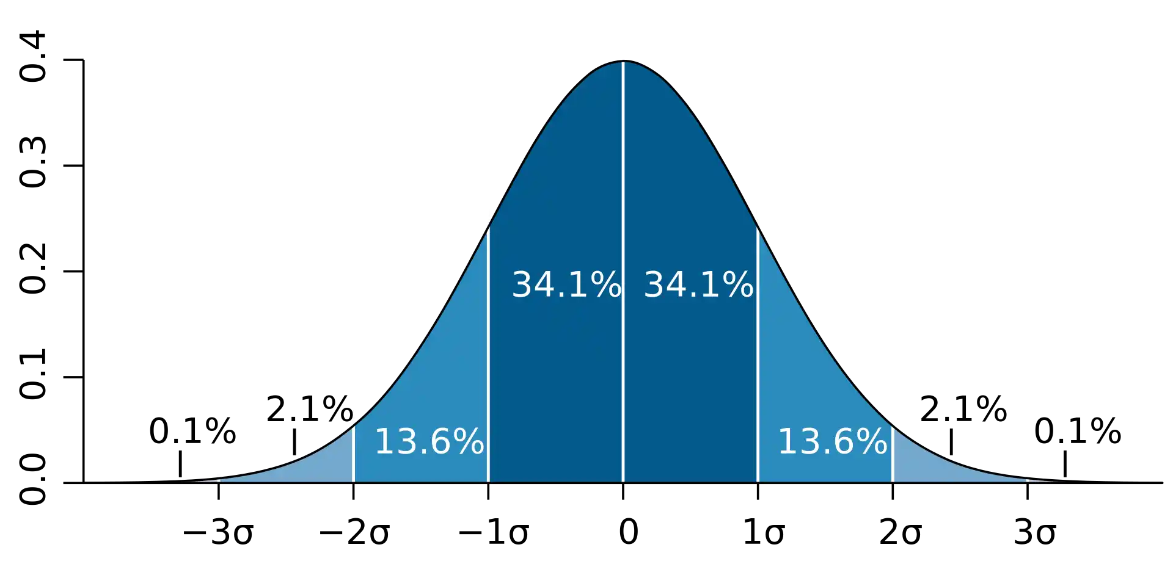
Outliers
3+ Standard Deviations from mean
Notes:
Next up, let's study outliers.
In certain data, there can be values that are much lower or much higher than the rest of the data.
There are many tests to identify outliers. You can do a simple standard deviation study, box-plot, or other more statistical tests.

Slide 11
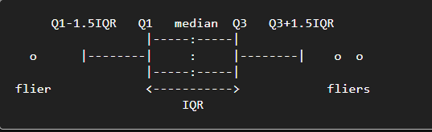
Outliers
Matplotlib definition
Notes:
The boxplot uses the median to calculate the Interquartile Range, which is where the bulk of the data observations will lie. I’m putting a link to a Youtube video on how to calculate IQR if you’re interested.
https://youtu.be/VTxydz2CYeY
Matplotlib will calculate whiskers as shown and observations lying outside of these whiskers can be considered as outliers.

Slide 12
Notes:
It's important to note that an outlier does not mean it's an incorrect value.
In this chart of the 2020 Net Worth of the percentiles of americans (Federal Reserve SCF Data, CPI Adjusted),
We see that the 99th percentile is much higher thank the rest. In fact, you probably can't see the blue column representing the 25th percentile which represents $12,430
In this case, the number for the 99th percentile is an outlier, but not an error. So we should include it in our data science models.
One thing that's not covered here is how many are in each percentile. We don't know how many outliers we have.
In many cases, you'll look at not just how far an outlier is from the mean, but how many of such records there are.
Maybe the 25th through 90th percentiles had 1000 records each and the 99th percentile had just one – consult the SME or stakeholder to see if they are good with removing it.
However, if you were looking at positional data, and the jet was travelling over Edwards AFB, and for a few seconds it showed that it transported to the North Pole and then was back to Edwards,
That would be most likely due to a glitch in the hardware that was recording the GPS data.
Sometimes you can determine a valid or invalid outlier by yourself, and other times you need the help of a domain expert.

Slide 13
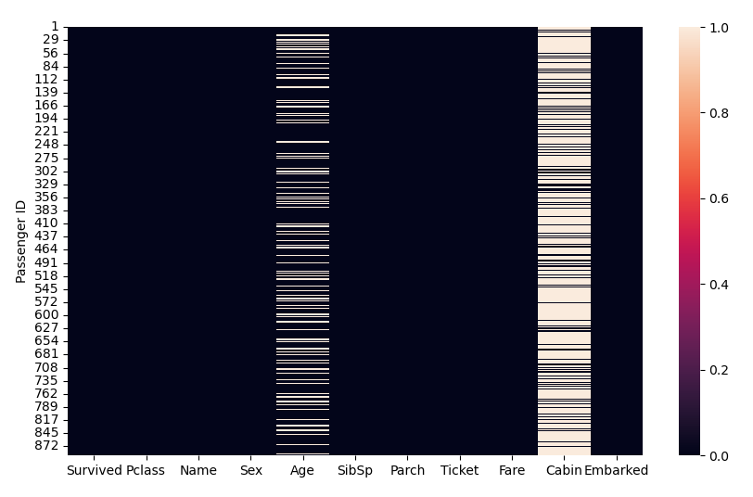
Missing Values
Notes:
Next let's look at missing values. This is a common problem with data collection.
In this case, there's a large body of data that's missing for several fields. Let's focus on Age.
It turns out that if you process only the data for the records with recorded ages, Age was an excellent variable to determine if you survived the Titanic disaster.
Because women and children were loaded onto the life-boats first
So you want to try to find or fill in that missing data. Sometimes you can look for other sources of data, such as census data.
Or you can try to estimate the missing data. Let's practice this.

Slide 14
Missing Values
Group by Salutation
Insert median value
Name | Age
Miss Laina Heikkinen | 26
Mrs. John Bradley Cumings | 38
Master Gosta Leonard Palsson | 2
Mr. Timothy McCarthy | 54
Notes:
One researcher separated the names from their salutations, calculated the median values of each category from records that were not missing, and then inserted those for the respective entries with missing data.
So this is a crude approximation. There were some older unmarried women and young married ones. But generally, unmarried women were younger than the married. And also generally someone listed as "master" was a child and therefore younger.
If your model wants to separate "young" vs "old" without needing to get into further refinement of age, something like this might be okay.
Whenever you substitute data, you want to log your reasoning and then check the results to see if conclusions you make based on this substituted data make sense.

